Slide 1
DESIGN AND IMPLEMENTATION OF A MOBILE-BASED ARCHIVAL AND RETRIEVAL OF MISSING OBJECTS APPLICATION USING IMAGE MATCHING
task 2: requirements gathering
Group one

Slide 2
OUTLINE
INTRODUCTION
REQUIREMENTS ELICITATION: METHODOLOGY AND RESULTS
STAKEHOLDER IDENTIFICATION
INTERVIEWING
SURVEYS
BRAINSTROMING
CONCLUSION

Slide 3
II. INTRODUCTION

Slide 4
II. requirements elicitation
methodology AND RESULTS

Slide 5
User requirements elicitation
Stake holder Identification and validation
Interviews
Surveys
Brainstorming

Slide 6
1. Stakeholder identification and analysis
Who is a stakeholder ?
Potential stakeholders
Random Individuals (end-users )
Development team
Business owner

Slide 7
2. Interviews
1) Related Organisations
Fako taxi union
Musango / Diamond traveling agencies
Police

Slide 8
requirements from related organizations
Need for better means of communication between parties of the system (owners and finders)
Easy means of reporting and being notified about found goods
Efficiency of the system in how fast goods are found
Low Cost or no cost demanded on individuals for finding their items

Slide 9
requirements from related organizations
Reliability in the validation of claims for found items
secureness of user information and privacy
Easy access to services and user friendliness
Simple procedures to report and retrieve missing items

Slide 10
II) End users
impressions and requirements
Awareness
ii. Money Incentive
iii. User account creation

Slide 11
II) End users
impressions and requirements
iv. User information
v. Road side camera integration
vi. Security concerns

Slide 12
3. ONLINE SURVEYS

Slide 13
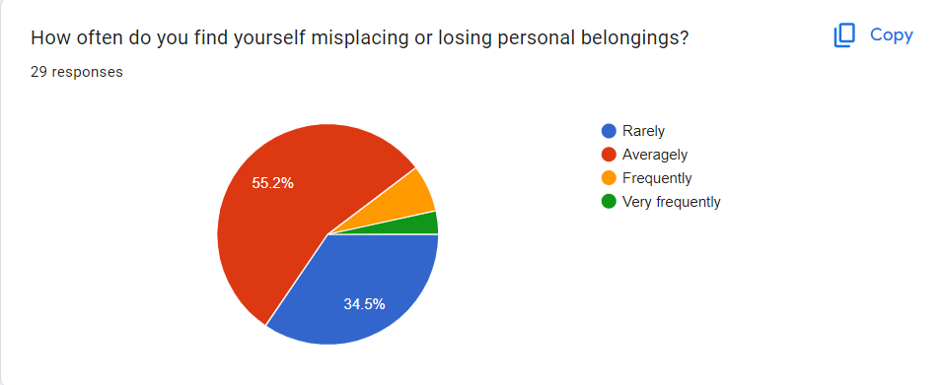

Slide 14
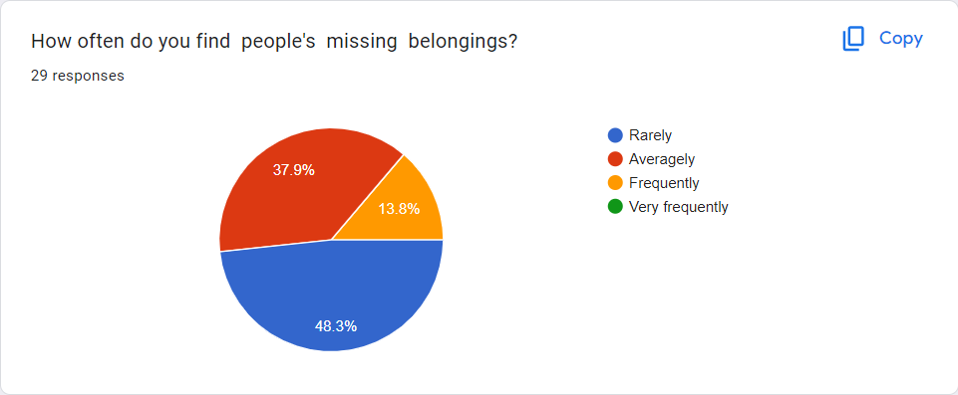

Slide 15
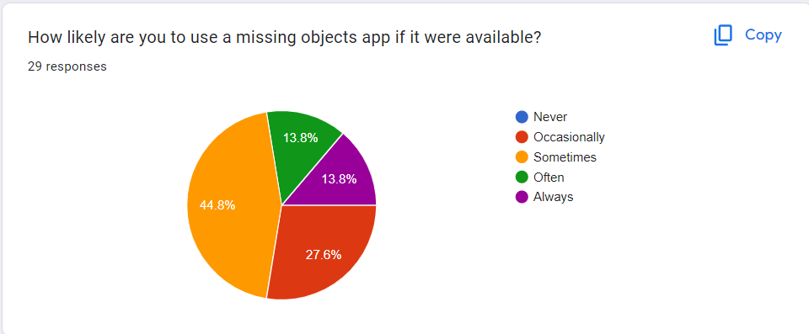

Slide 16
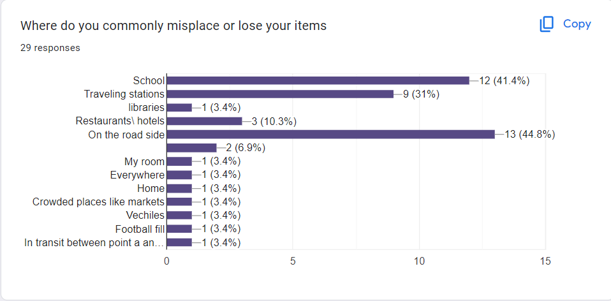

Slide 17
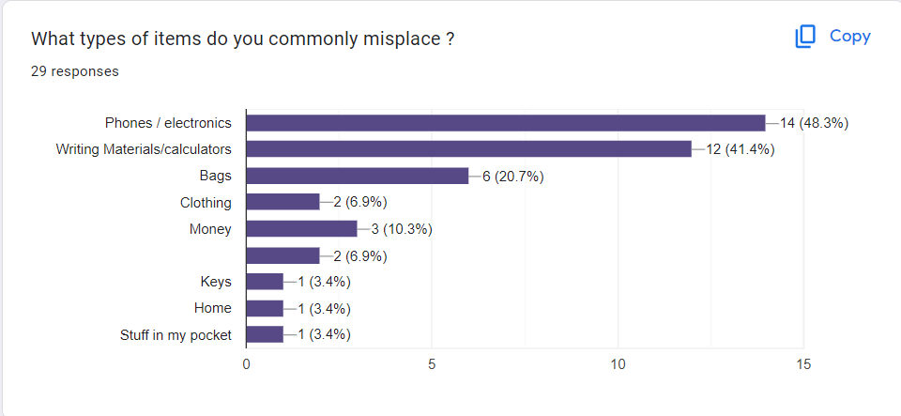

Slide 18
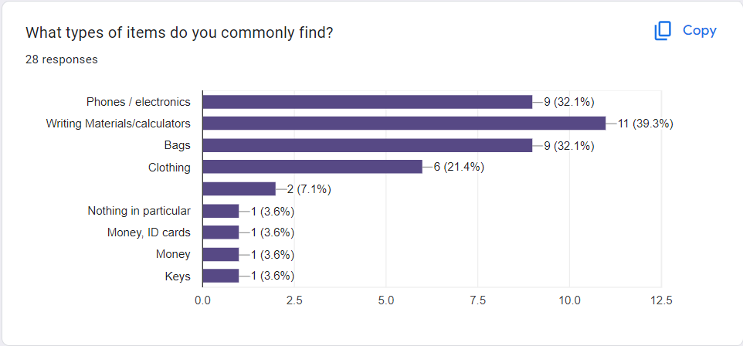

Slide 19
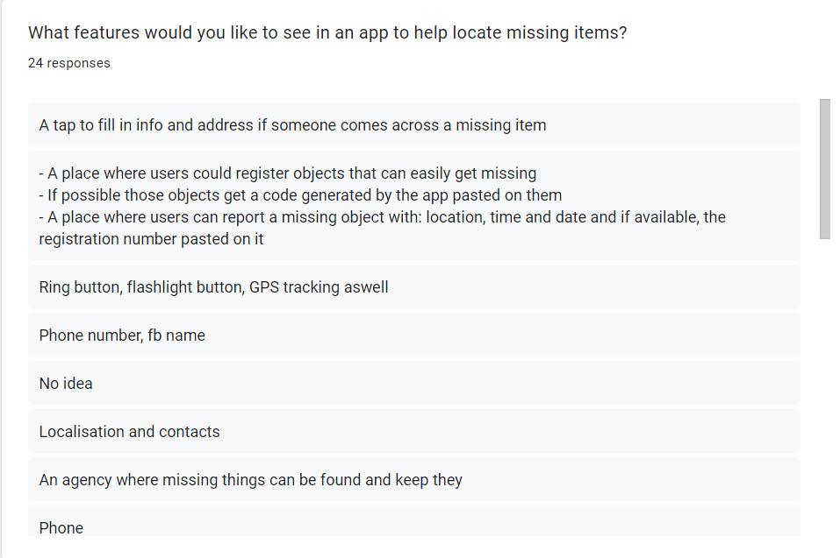

Slide 20
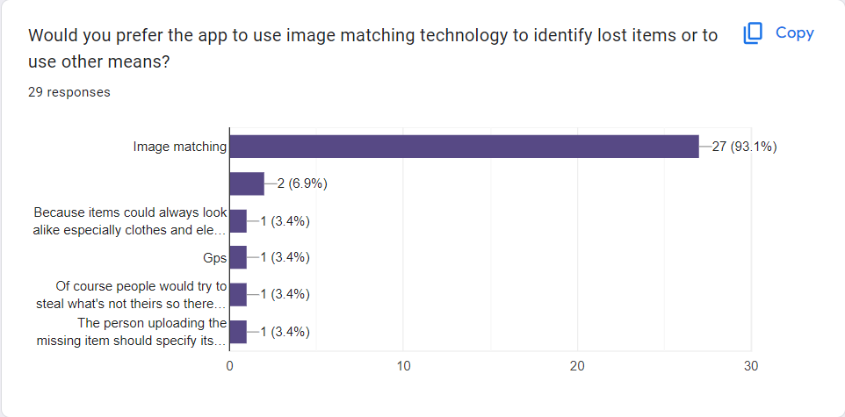

Slide 21
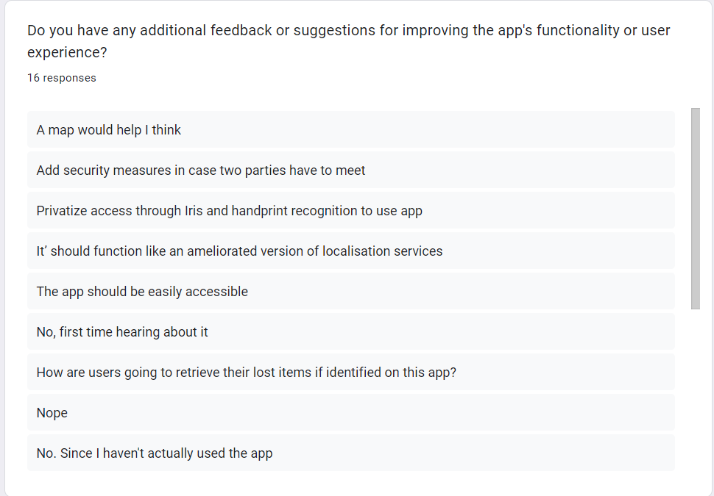

Slide 22
Requirements gotten from Online survey
Ease of use and good user experience
Reward system for those who find items
Text, camera, calls integration for easy communication between owners and finders
Notification services
Live location between someone who has found it and me or a ping to the item
Free access and availability to all

Slide 23
Requirements gotten from online survey
Communication features to help facilitate the finding and receiving of a lost item. That is, social communication updates on missing items.
A map, probably to locate certain points
A tap to fill in info and address if someone comes across a missing item
A place where users could register objects that can easily get missing
Issuing of codes to lost and found items to ease matching

Slide 24
Requirements gotten from online survey
A place where users can report a missing object with: location, time and date and if available, the registration number pasted on it
Phone number, Facebook names to help communication between parties
Localization and contacts
An agency where missing things can be found and kept
Phone tracking services

Slide 25
Requirements gotten from online survey
Chat option to link finder and seeker
GPS integration
An intuitive user interface, image recognition and matching, available offline, being able to upload and search images by description.
Location services
A sort of community where for reporting missing and found items

Slide 26
Requirements gotten from online survey
Adding details about the Place of missing item, place found, monitoring device, account
The need for the implementation of image matching system to the application
The main types of items to prioritize when developing the system
The need to make the system as a whole easy to use, convenient, reliable and available to all in order to facilitate their daily struggles in finding lost items.

Slide 27
4. BRAINSTORMING

Slide 28
REQUIREMENTS GOTTEN FROM BRAINSTORMING
A CROSS PLATFORM MOBILE APP
AN INTUITIVE USER INTERFACE
USER AUTHENTICATION
OBJECT REGISTRATION
SEARCH AND RETRIEVAL

Slide 29
REQUIREMENTS GOTTEN FROM BRAINSTORMING
VI. COMPENSATION TO FOUNDER OF LOST ITEM
VII. A LITTLE TOKEN FROM THE BENEFICIARY
VIII. NOTIFICATIONS
IX. FAST RECOVERY OPTION
X. FEEDBACK MECHANISM

Slide 30
REQUIREMENTS GOTTEN FROM BRAINSTORMING
XI. SECURITY
XII. PERFORMANCE
XIII. USABILITY
XIV. ACCESSIBILITY
XV. COMPATIBILITY

Slide 31
REMEDY TO SOME SHORTCOMINGS POINTED OUT BY STAKEHOLDERS DURING THE REQUIREMENT GATHERING PROCESS

Slide 32
Problem : compensations might increase the rate of theft in the society
REMEDY
Verification process:
- Users will be required to provide sufficient evidence or verification before receiving compensation for retrieving a missing item e.g (photo evidence, ID cards, contact etc)

Slide 33
Problem : compensations might increase the rate of theft in the society
REMEDY
Delayed compensation:
- Here, the reward is only provided after a certain period to ensure legitimacy of the retrieval and discourage opportunistic theft

Slide 34
Problem : Insecurity during exchange retrieval of items
REMEDY
System office:
- Establishment of a system office where the exchange is being done. The founder and beneficiary need not meet physically if not necessary.

Slide 35
Iv . Conclusion

Slide 36
In conclusion, the requirements gathering phase for the “mobile-based app for archival and retrieval of missing objects has been comprehensive and insightful. Through the collaboration of the technical team, stakeholders and related organizations. With this information, we can move to the REQUIREMENTS ANALYSIS phase.

Slide 37
THANK YOU

Slide 38
END
NAME | MATRICULE
MEWOABI NGUEFACK DORE | FE21A239
ALEANU NTIMAEH ENOW | FE21A134
OJONG-ENYANG OYERE | FE21A297
FONGANG KELUAM PAUL DIEUDONNE | FE21A193
TANWIE BRUNO ADEY | FE21A316

